Slide 1


Multiantenna-Assisted
Spectrum Sensing for
Cognitive Radio
Pu Wang, Student Member, IEEE, Jun Fang, Member, IEEE, Ning Han, Student Member, IEEE, and Hongbin Li, Senior Member, IEEE

Slide 2

01
INTRODUCTION

Slide 3


What is Cognitive Radio (CR)?
Cognitive Radio is like a smart navigation system that allows public drivers (secondary users) to intelligently find and use these empty private superhighways (primary users' licensed spectrum) without causing any traffic jams or accidents for the owners.
Primary Users (PUs):
Secondary Users (SUs):
The licensed owners of a specific frequency band. They have priority access.
Unlicensed users who want to opportunistically use the band when the PU is not transmitting.
White Space: A frequency band that is not being used by the PU at a particular time and in a particular location.
The Goal of CR: To improve the efficiency of radio spectrum usage. Current management assigns exclusive licenses, but studies show that much of this licensed spectrum is underutilized.

Slide 4
What is Spectrum Sensing?
Spectrum sensing is the most fundamental requirement of a Cognitive Radio. It is the process by which the secondary user (SU) listens to the radio environment to determine if a primary user (PU) is present.
PU is absent
PU is present
The SU can use the frequency band.
The SU must vacate the band immediately to avoid causing harmful interference.
For applications like cognitive radios in vehicles, this detection must be extremely fast and accurate, as the vehicle is constantly moving through different radio environments.

Slide 5

02
PROBLEM

Slide 6
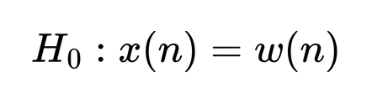
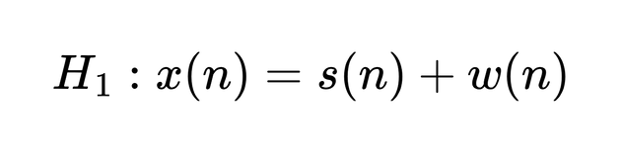
The Problem: A Hypothesis Test
Mathematically, spectrum sensing is a binary hypothesis testing problem. The SU receives a signal
Hypothesis H0​ (Null):
The PU is absent. The received signal is just random background noise
Hypothesis H1​ (Alternative):
The PU is present. The received signal is the PU's signal, s(n), plus the background noise, w(n)

Slide 7

Common (But Flawed) Sensing Methods

Slide 8
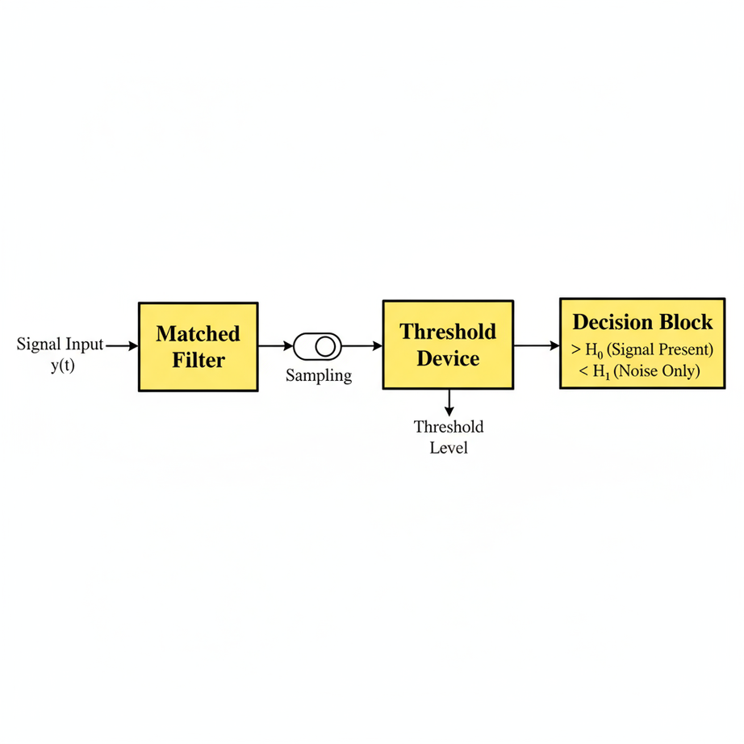
Matched Filter Detection
The Method: This is considered the optimal detection method when you have complete information about the signal you're looking for. It works by correlating the incoming signal with a known replica of the primary user's (PU) signal. A high correlation value indicates the presence of the PU.
The Flaw: Its major drawback is the need for perfect a priori knowledge of the PU's signal, including details like modulation type, pulse shaping, and precise timing. In a cognitive radio scenario, a secondary user (SU) rarely has this information, making the matched filter impractical for most real-world applications.

Slide 9
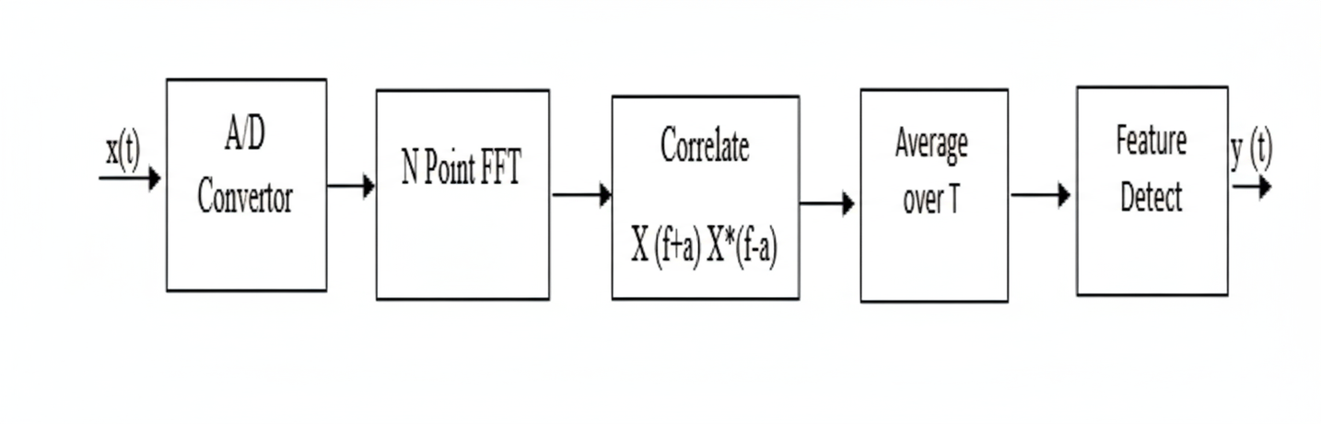
Cyclostationary Feature Detection
The Method: This technique exploits the fact that man-made communication signals have hidden periodicities in their statistical properties (like mean and autocorrelation) due to processes like modulation and carrier frequencies. These repeating patterns, or "cyclic frequencies," are not present in random noise. By searching for these specific signatures, this method can reliably distinguish a signal from noise.
The Flaw: This method has two main disadvantages. First, it requires prior knowledge of the PU's cyclic frequencies, which may not be available to the SU. Second, it is computationally very complex and demanding, which makes it difficult to implement in real-time systems.

Slide 10
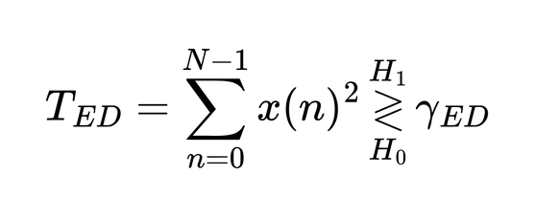
Energy Detector (ED)
The Method: This is the simplest and most common approach because it doesn't require any information about the PU's signal. It operates by measuring the total energy of the received signal within a specific frequency band over a certain period. If this measured energy exceeds a predetermined threshold, the detector declares that a PU is present.
The Flaw: The ED's biggest weakness is its high sensitivity to uncertainty about the noise power. The detection threshold is set based on an estimate of the background noise. However, in practice, noise levels can fluctuate due to factors like temperature changes or radio interference. If the actual noise power is even slightly different from the estimate, the ED's performance degrades significantly, leading to either missed detections of the PU or frequent false alarms.

Slide 11
03
PROPOSED SOLUTION

Slide 12
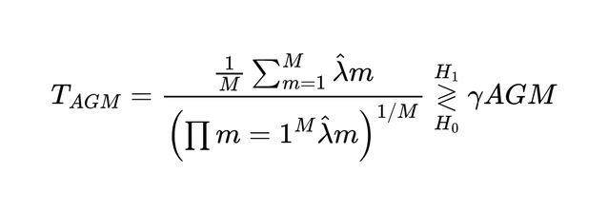
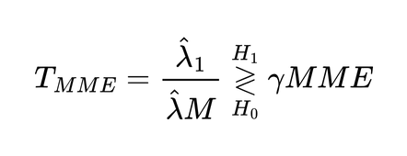
Proposed Solution
The Maximum Likelihood Estimate (MLE) of the unknown parameters is used to obtain the test statistic, which serves as the Generalized Likelihood Ratio Test (GLRT) detector for the hypothesis testing framework.
We will compare the performance of the GLRT detector with the following spectrum sensing methods:
Energy Detector (ED)
Energy Detector with Uncertainty (ED-U)
Autocorrelation-based Geometric Mean (AGM), defined as -
Maximum-Minimum Eigenvalue (MME), defined as -

Slide 13
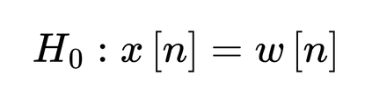
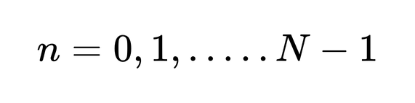
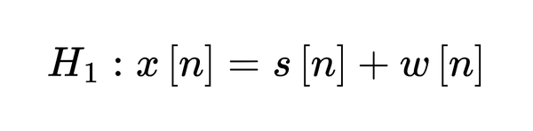
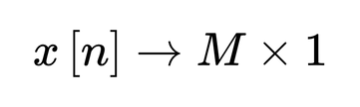
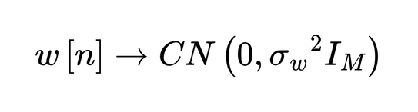
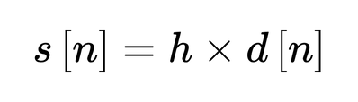
Signal Model
baseband equivalent of the received signal
d[n] are the symbols sent by the primary user
h is a M x 1 matrix which are the channel coefficients
Under H0 the noise variance σw2 is unknown
Under H1 the noise variance σw2 and filter coefficient matrix h are unknown

Slide 14
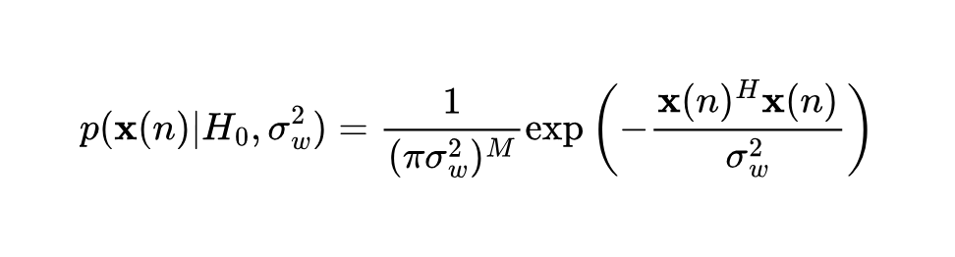
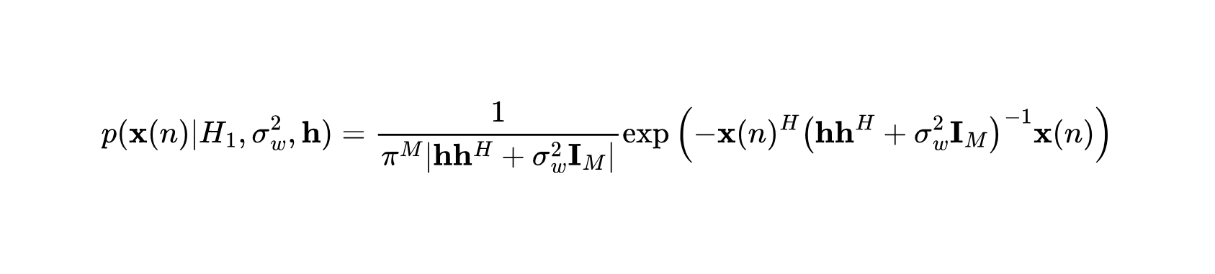
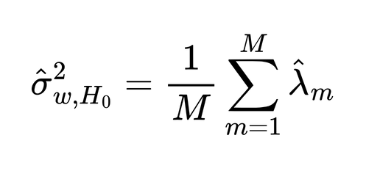
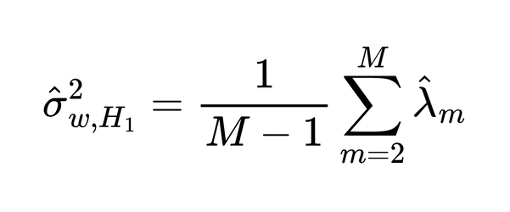
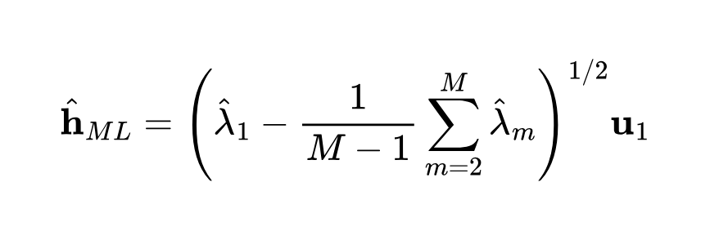
PDF and MLE

Slide 15
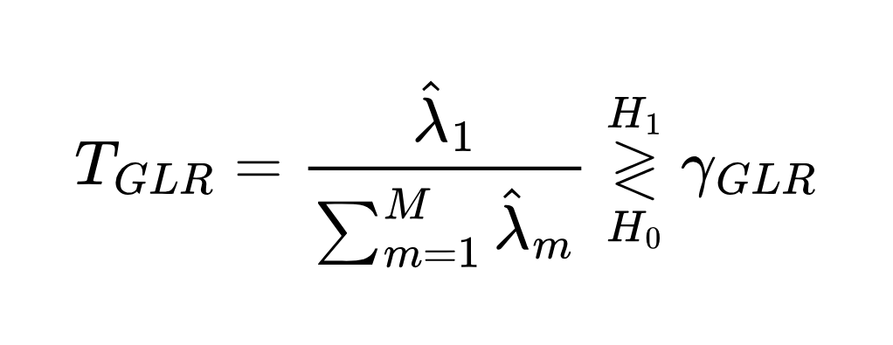

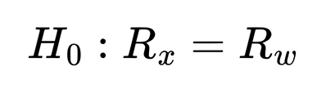
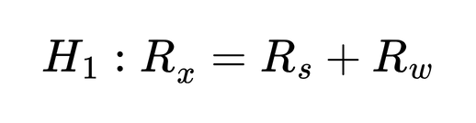
GLRT Test Statistic
Here s are the eigenvalues of the sample covariance matrix Rx

Slide 16
04
Simulations/
Future Improvements

Slide 17
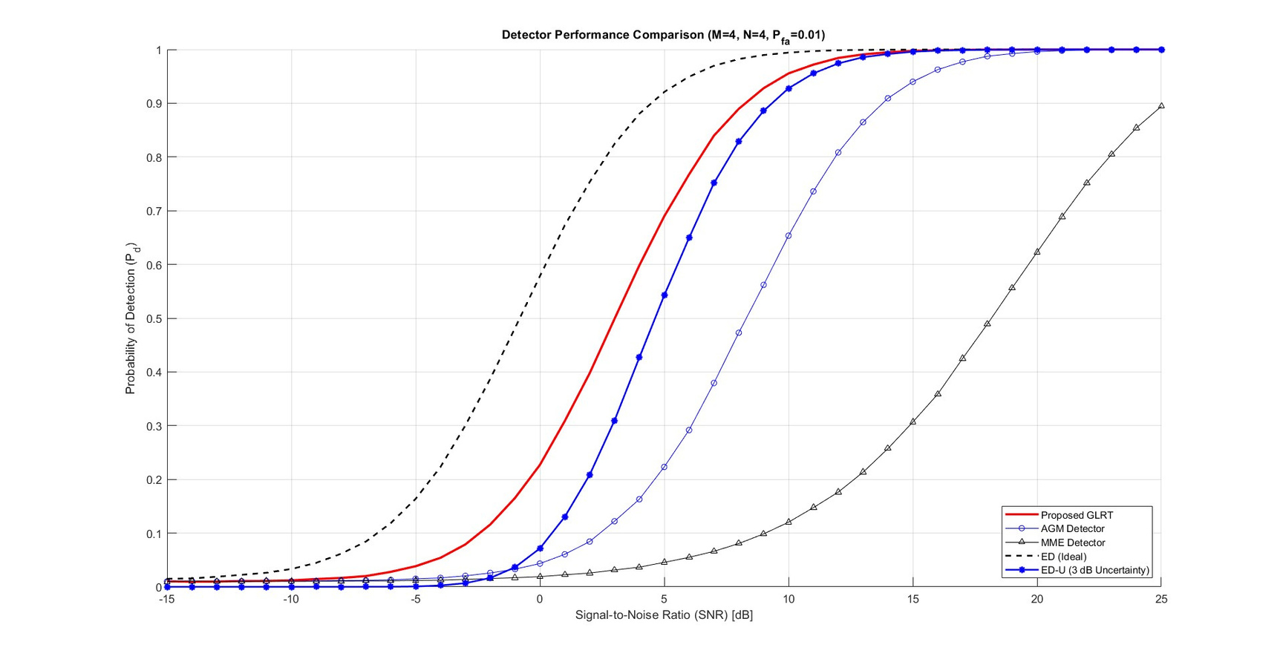
Simulations
https://github.com/Git-Silk/GLRT-for-Spectrum-Sensing-in-Cognitive-Radio

Slide 18
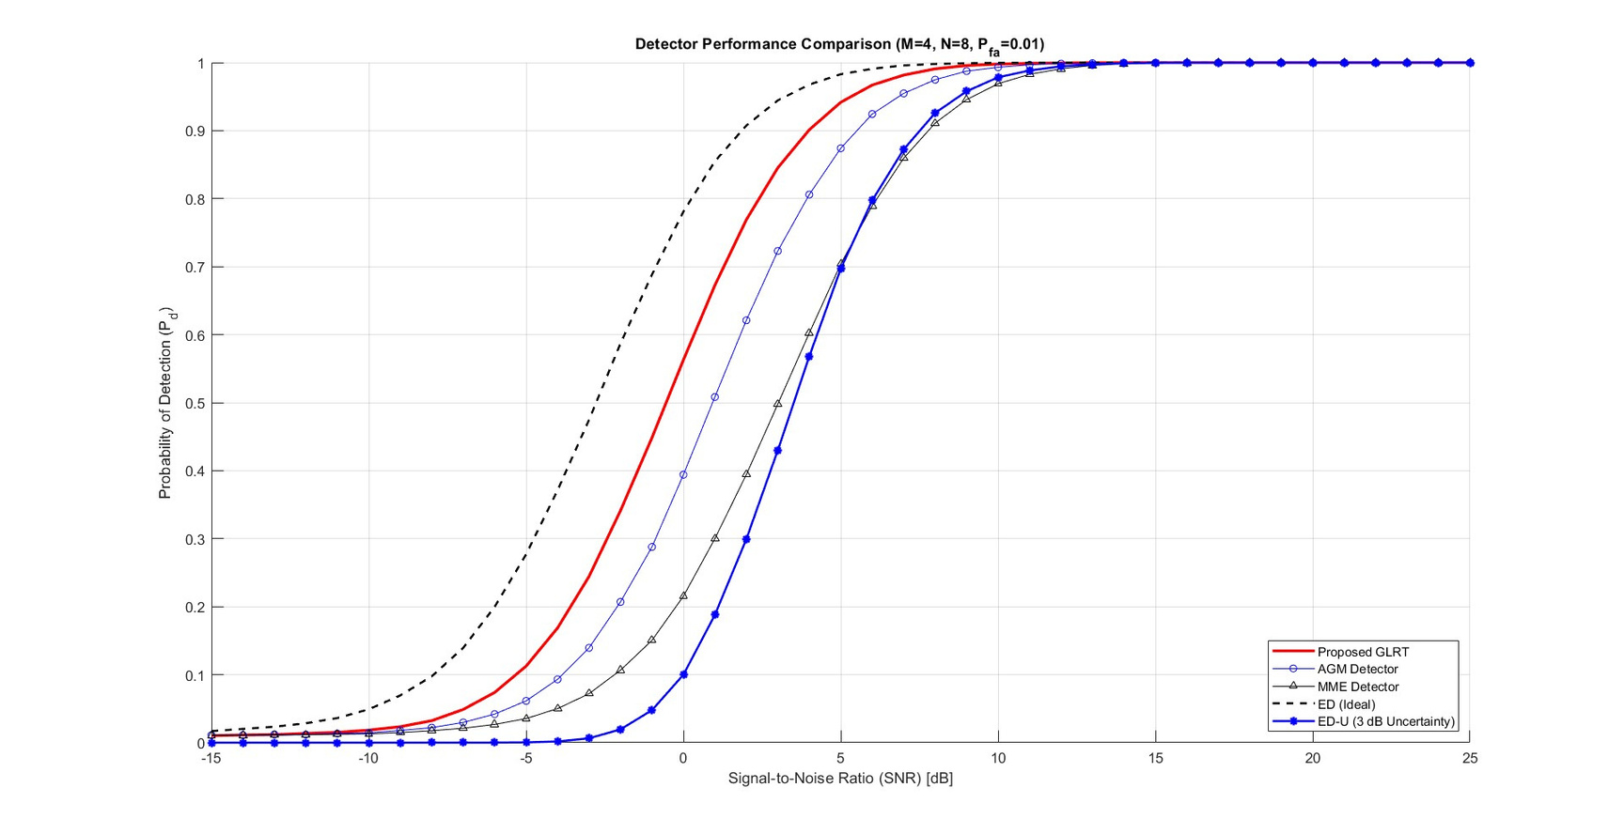
Simulations
https://github.com/Git-Silk/GLRT-for-Spectrum-Sensing-in-Cognitive-Radio

Slide 19
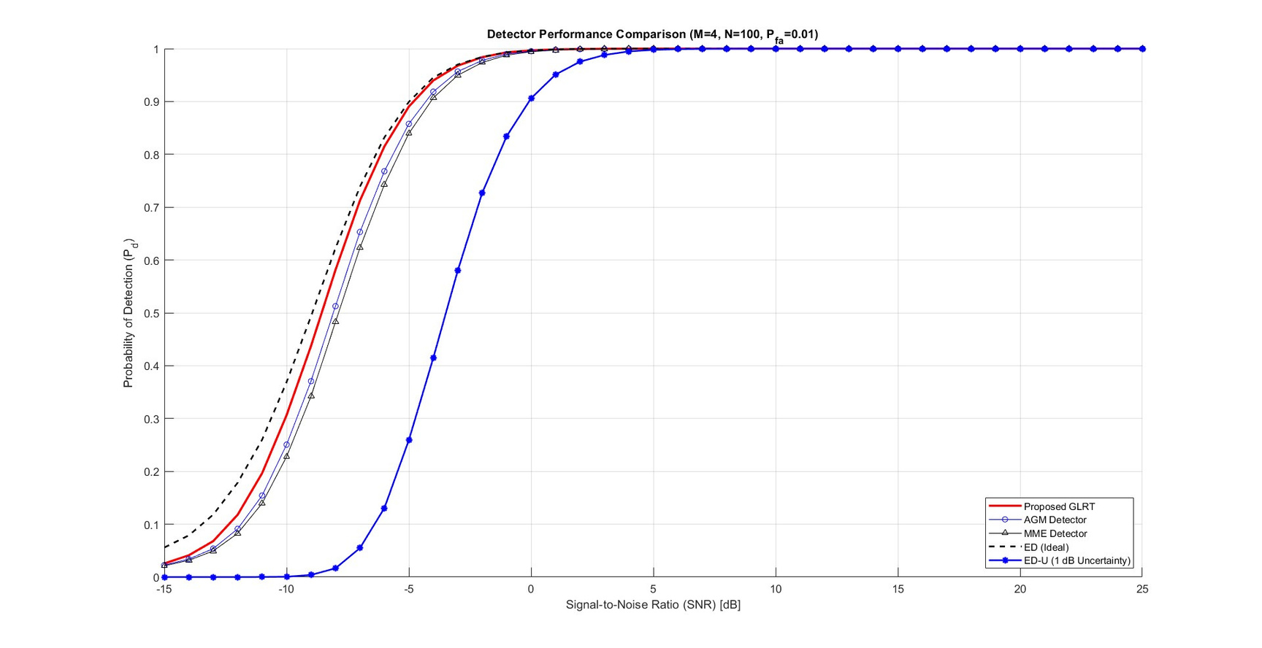
Simulations
https://github.com/Git-Silk/GLRT-for-Spectrum-Sensing-in-Cognitive-Radio

Slide 20
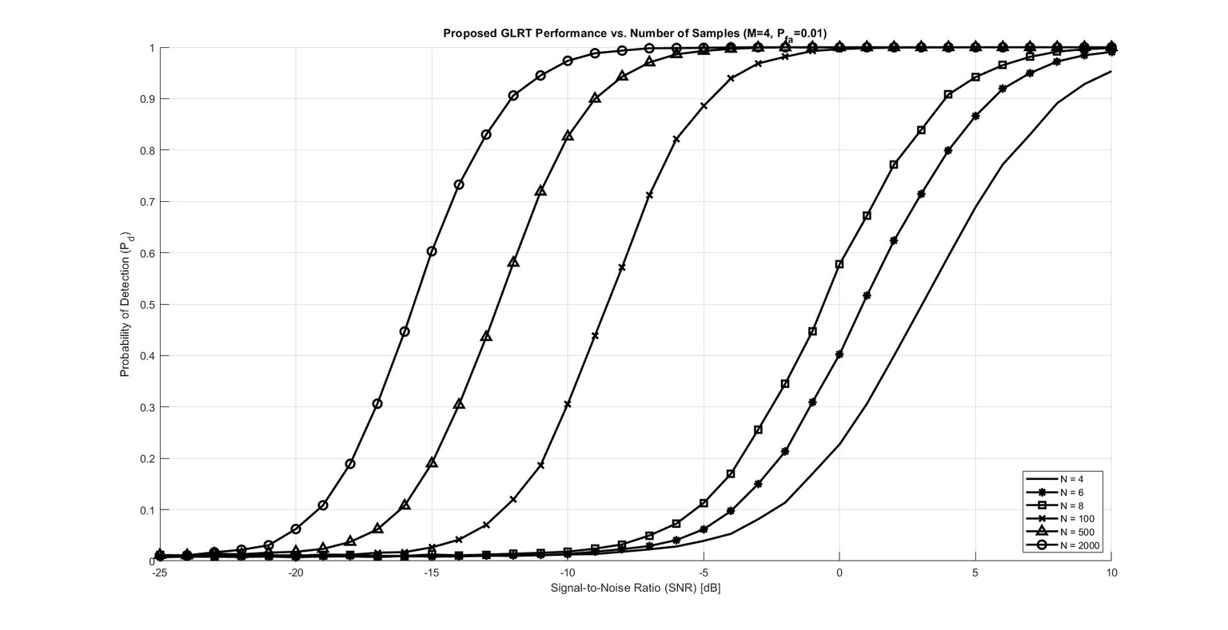
Simulations
https://github.com/Git-Silk/GLRT-for-Spectrum-Sensing-in-Cognitive-Radio

Slide 21
Future Improvements
We could try to extend the same model for multiple PUs
2. Consider coloured noise instead of white noise
https://github.com/Git-Silk/GLRT-for-Spectrum-Sensing-in-Cognitive-Radio

Slide 22


Thank You
Aryaman | Uday

